Slide 1
We need to change the education system,
but we can't force everyone at once.

Slide 2
Let's start with college!

Slide 3
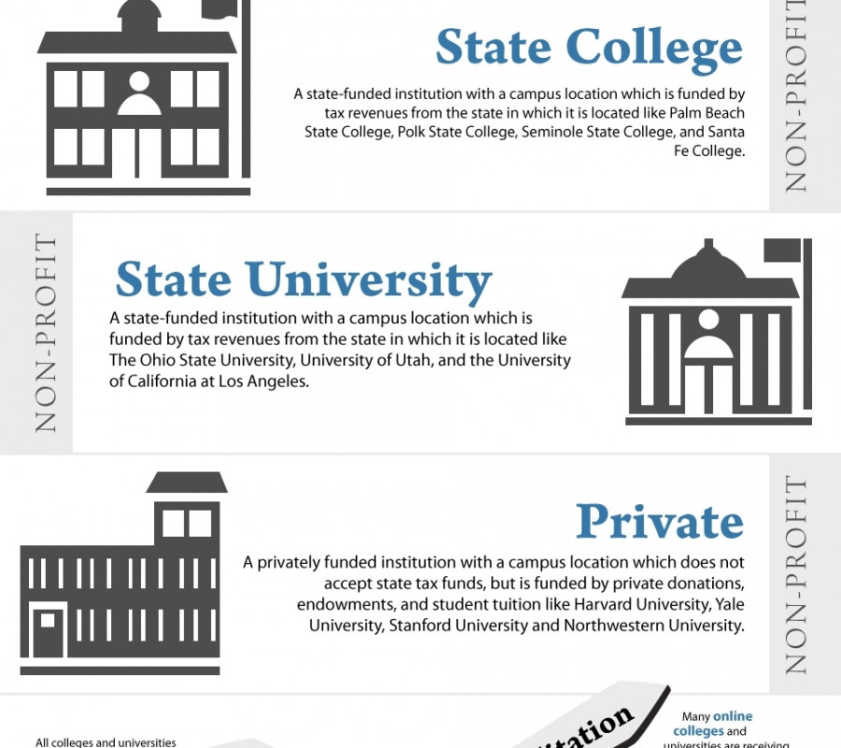
Types of colleges
University
State
Private
Community
Technical
Arts

Slide 4
What are the problems?

Slide 5
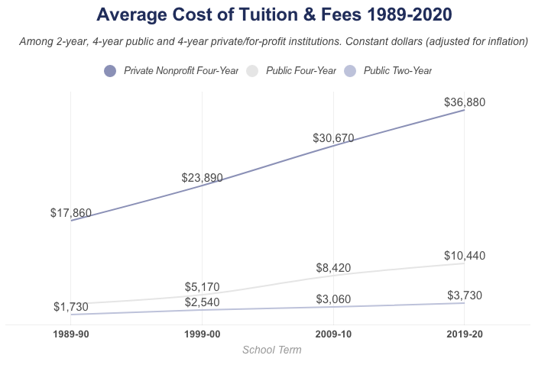
Too expensive
Notes:
Caused by increase in students, the need out ways the cost, financial aid enable increase in fees, state funding is spread too thin because of the increased enrollment, professor costs have gone up because they think they are worth more, more services are available which get put into the cost.

Slide 6
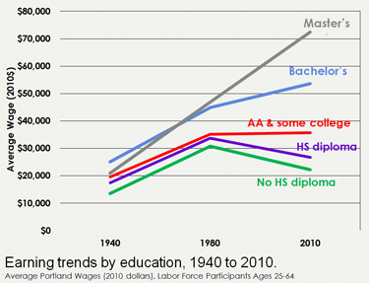
Doesn’t always help with your career
Notes:
now it just stands as a prerequisite in the workforce. 62% of recent college graduates are working in jobs that require a degree, yet only 27% of college graduates are working in a job that even relates to their major. Employers want to know that you will be able to learn quickly, fit into the workplace environment, and be responsive to the task at hand.

Slide 7
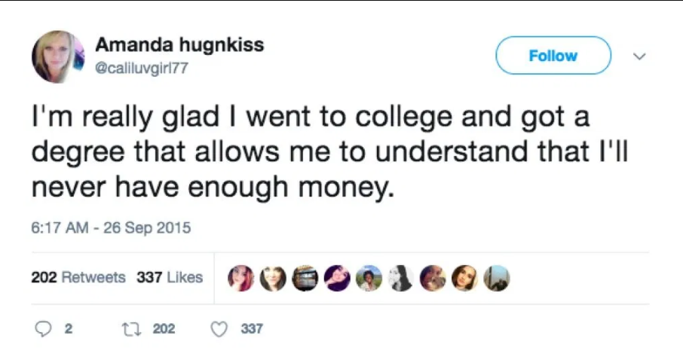
No real-world experience is learned.

Slide 8
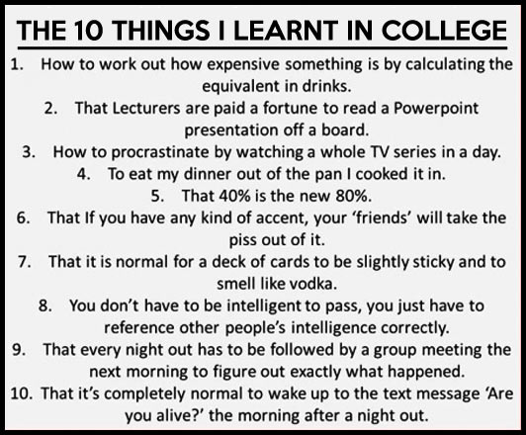

Slide 9
WHAT CAN we CHANGE TO HELP SOLVE THIS PROBLEM?

Slide 10

OPTION 1 – More trade school degrees

Slide 11
OPTION 2 – Change the 4 year degree format

Slide 12
OPTION 3 – Update degree’s

Slide 13
OPTION 4 – ALL OF THE ABOVE !!!!!

Slide 14
HOW WILL these SOLUTIONs IMPROVE THE EDUCATION SYSTEM?

Slide 15
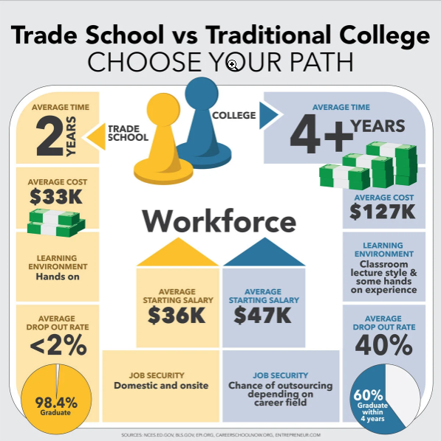
OPTION 1 – More trade school degrees
2 years (more time to work)
Lower average cost
In person, hands on learning
Lower dropout rate
Notes:
Fills need for the students that are only interested in working and building skills. As said before employers look at previous jobs a lot more then degrees so starting to work early and build up could be the best solution to not having real skills after 4 years.

Slide 16
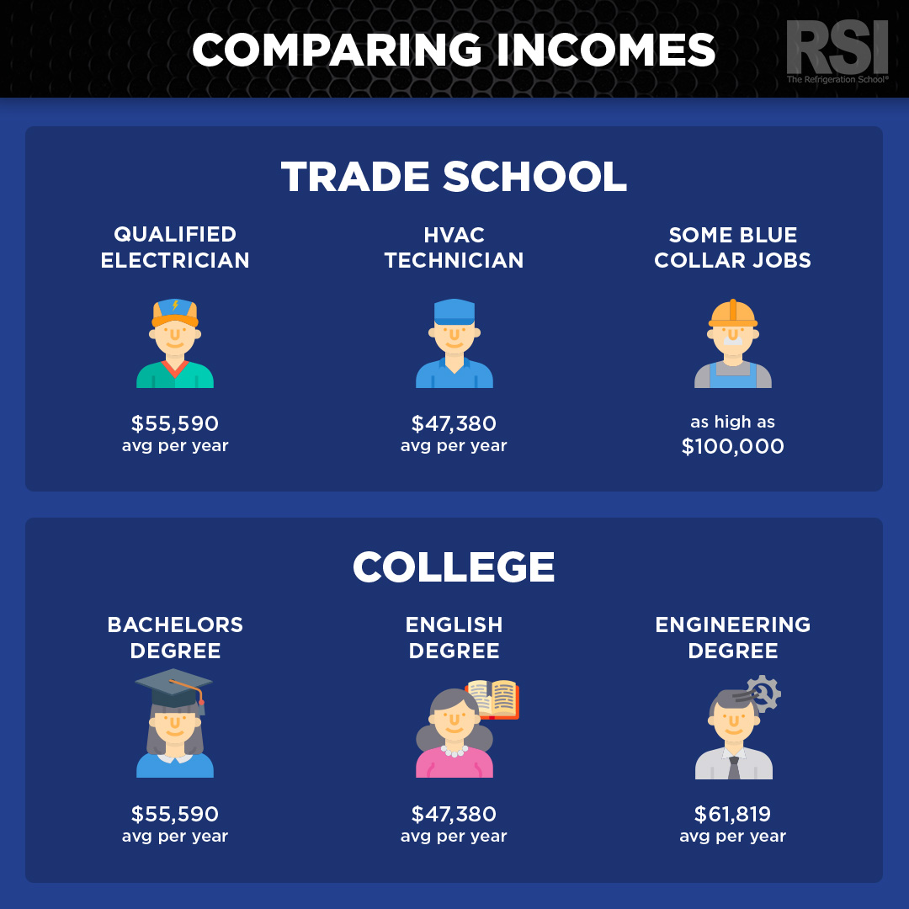

Slide 17
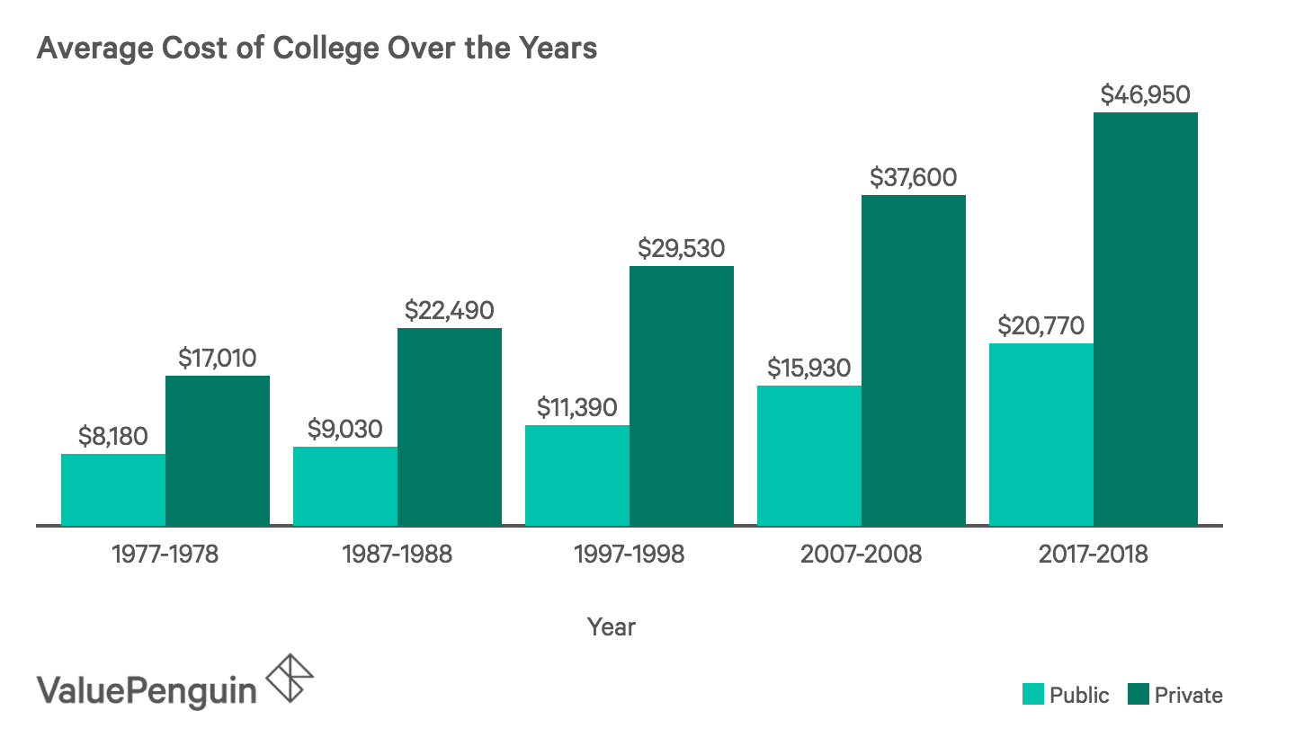

Slide 18
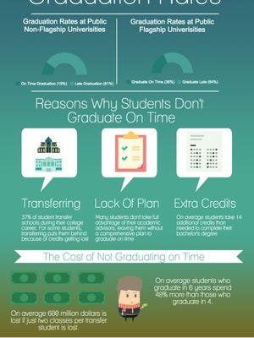
OPTION 2 – Format change
First year no official declared degree
1 year of required classes about how to “life” (economics, civics, mental health, food & nutrition, etc.)
After first year you declare degree path.
Allows for students to learn more about the world.
4 years in total

Slide 19

OPTION 3 – Update degree’s
Change degree requirements based on current career climate.
Possible add of other classes that are needed.
Require real world experience to finish degree.
Eliminate degrees that have low income/success rates.

Slide 20
WHAT NEEDS TO HAPPEN?

Slide 21

The students need to speak their mind!
The more we as students talk about change the more likely it is to happen.

Slide 22

New schools need to jump on board!
The newer and smaller the school the more likely they are to change.

Slide 23

Trial runs
After multiple smaller schools have “tested the waters” it will be much easier to convince larger ones to change.

Slide 24
“Change will not come if we wait for some other person or some other time. We are the ones we’ve been waiting for. We are the change that we seek.” -Barack Obama

